Slide 1

Pharmacy Management System – Product Documentation
Catherine M. Ata
School of Technology & Computing (STC)
City University of Seattle
CC504 Software Engineering Individual Project

Slide 2
Agenda
Problem Statement
Documentation: Shell
Documentation: Video
Sample Billing Statement
After Action Review
Reference

Slide 3
Problem Statement
These user specific tutorial videos and shells of the system pages aim to provide guidance to new users through the various tasks or functionalities featured in the system.

Slide 4
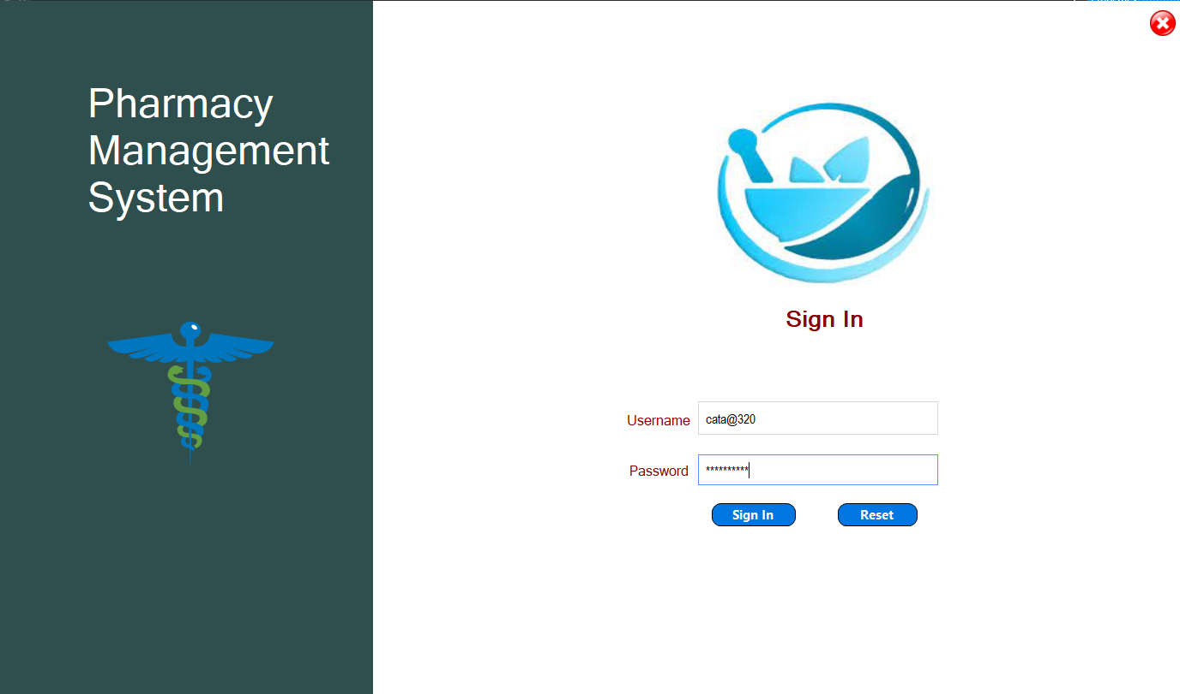
Documentation: Shells
Image 1. Log In Page

Slide 5
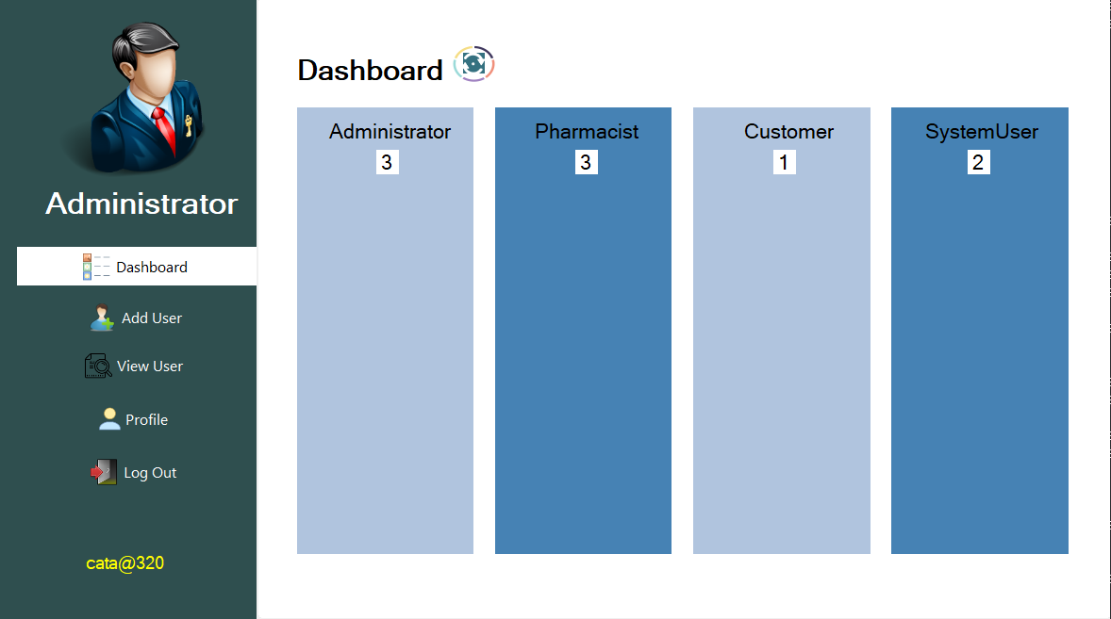
Documentation: Shells
Image 2. Administrator Dashboard

Slide 6
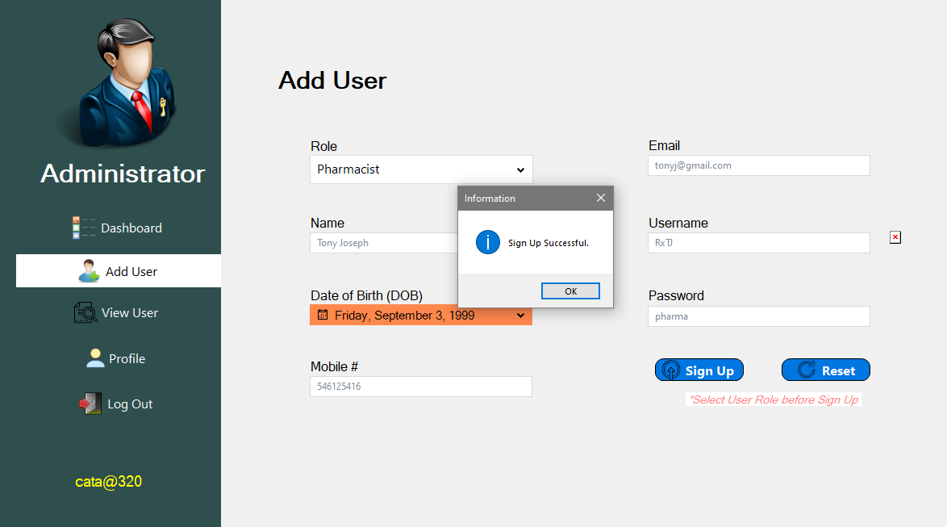
Documentation: Shells
Image 3. Administrator Control: Add User

Slide 7
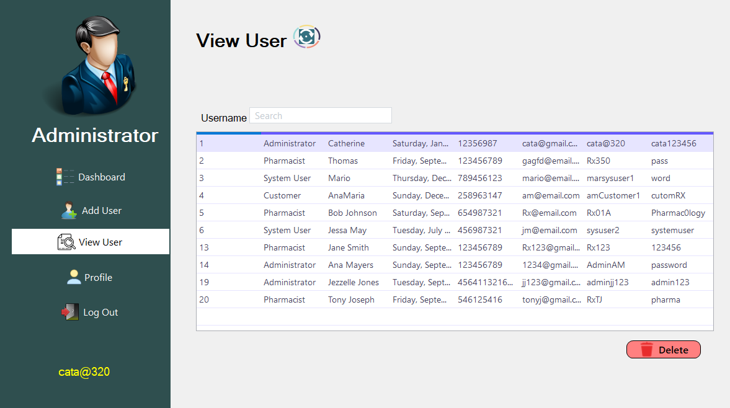
Documentation: Shells
Image 4. Administrator Control: View and Delete User

Slide 8
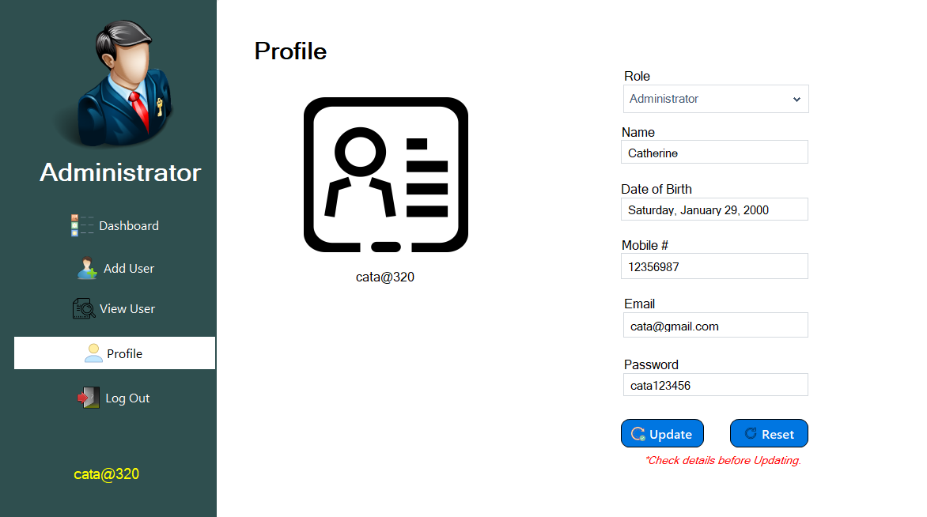
Documentation: Shells
Image 5. Administrator Control: View and Update Profile

Slide 9
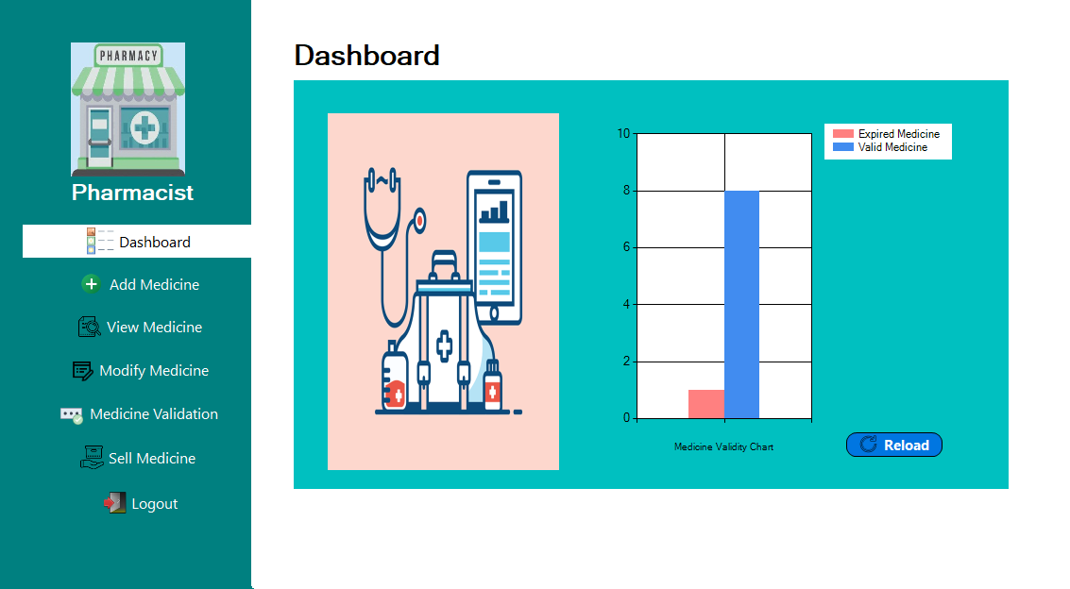
Documentation: Shells
Image 6. Pharmacist User Dashboard

Slide 10
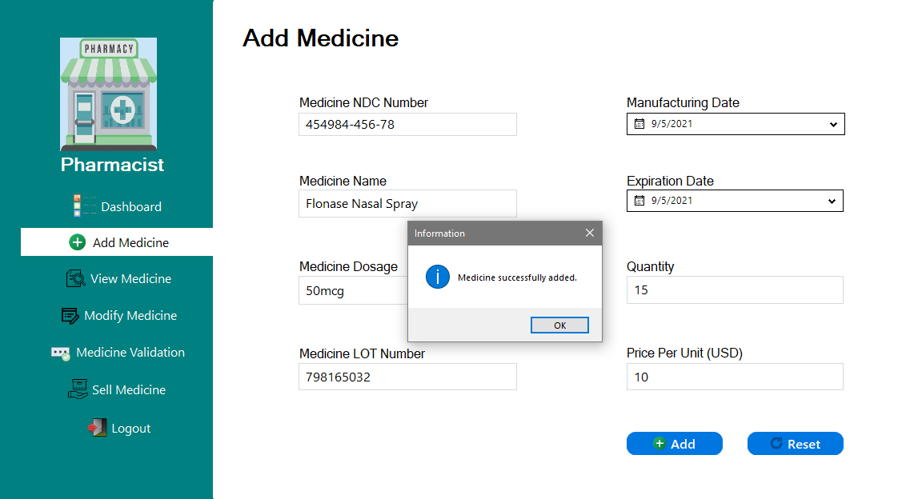
Documentation: Shells
Image 7. Pharmacist User Control: Add Medicine

Slide 11
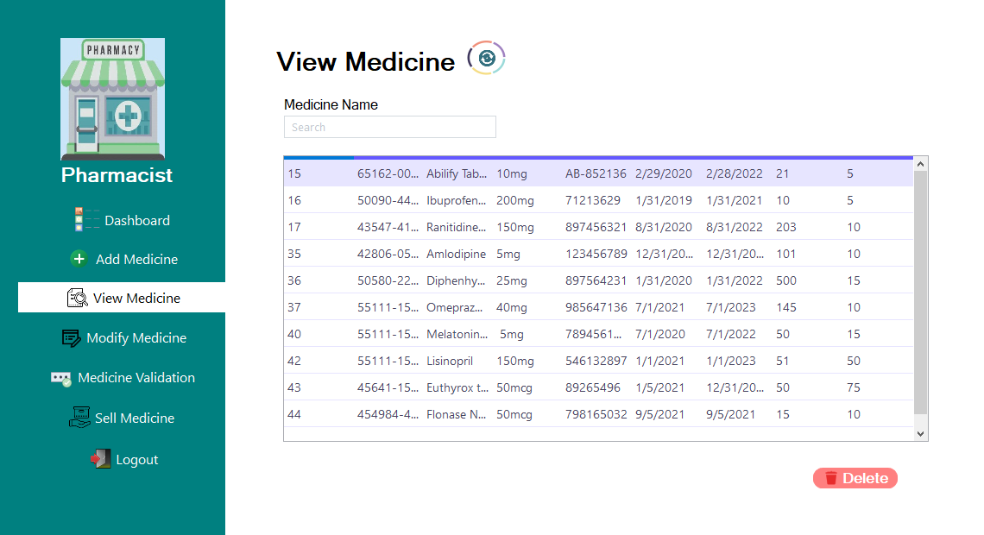
Documentation: Shells
Image 8. Pharmacist User Control: View and Delete Medicine

Slide 12
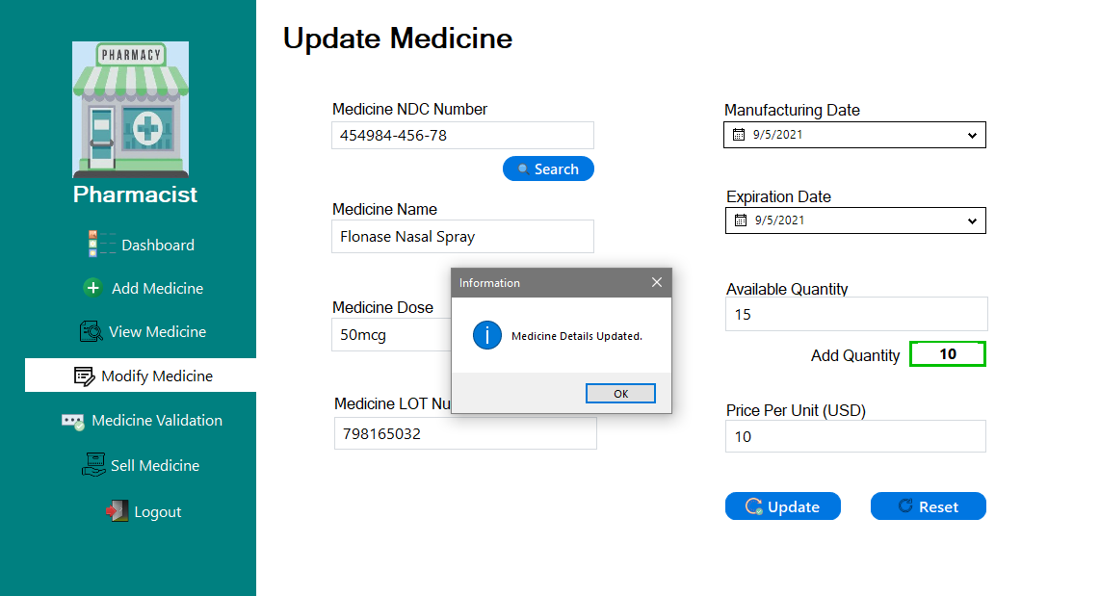
Documentation: Shells
Image 9. Pharmacist User Control: Update Medicine

Slide 13
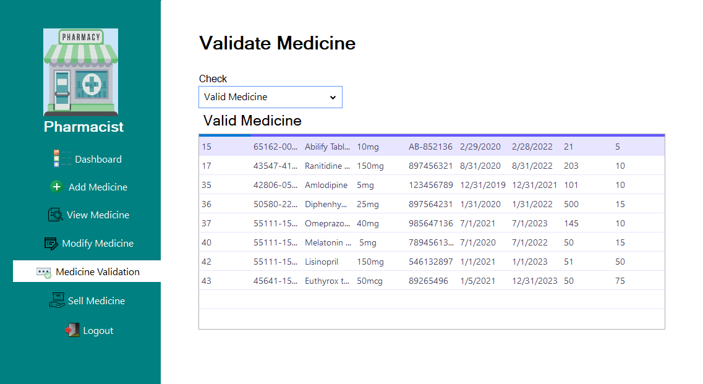
Documentation: Shells
Image 10. Pharmacist User Control: Validate Medicine

Slide 14
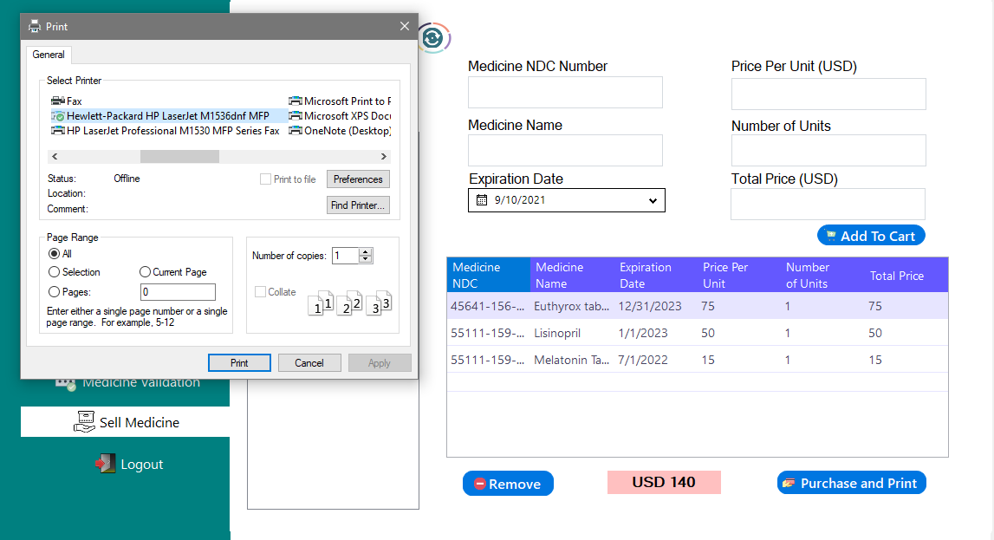
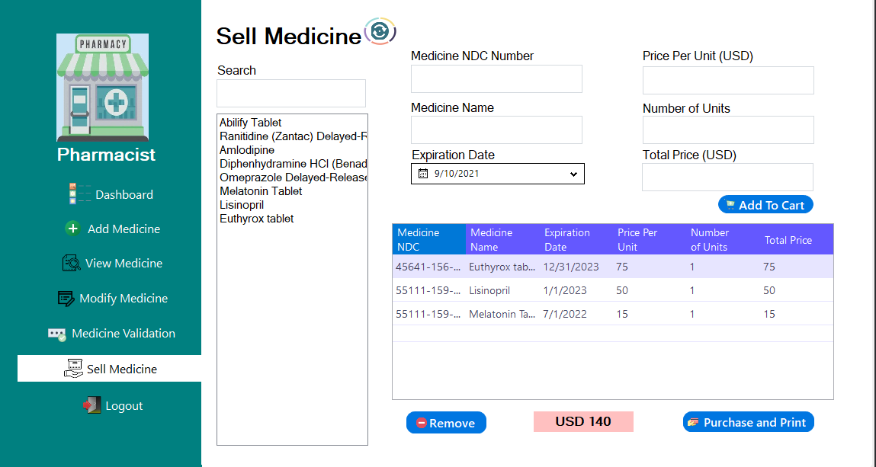
Documentation: Shells
Image 12. Pharmacist User Control: Create Bill
Image 11. Pharmacist User Control: Sell Medicine

Slide 15
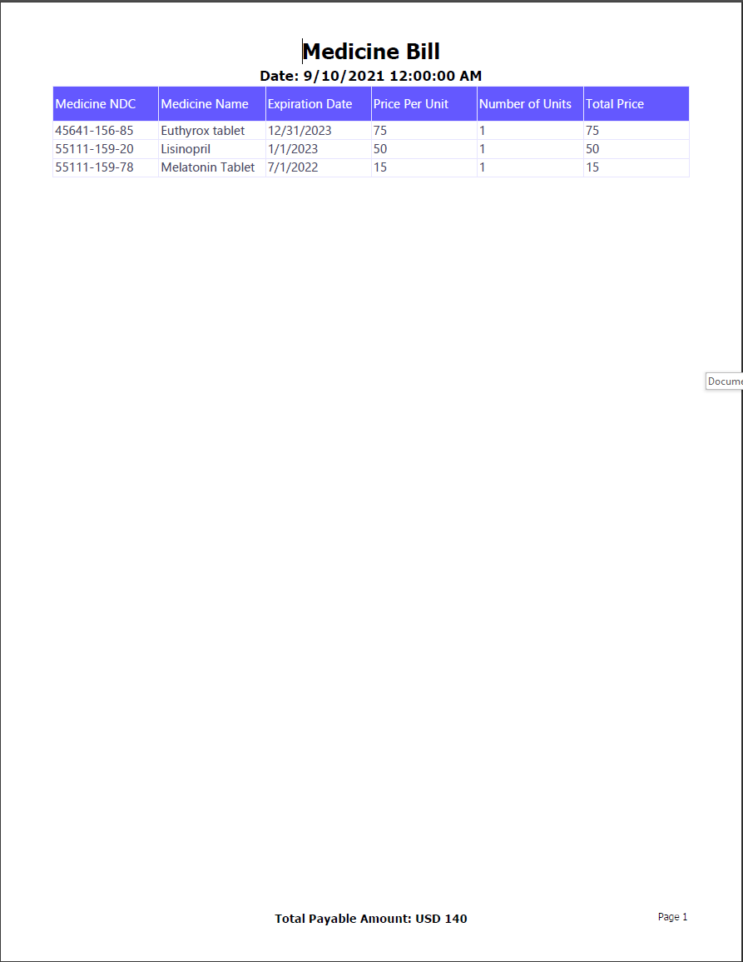
Documentation: Shells
Sample Billing Statement

Slide 16
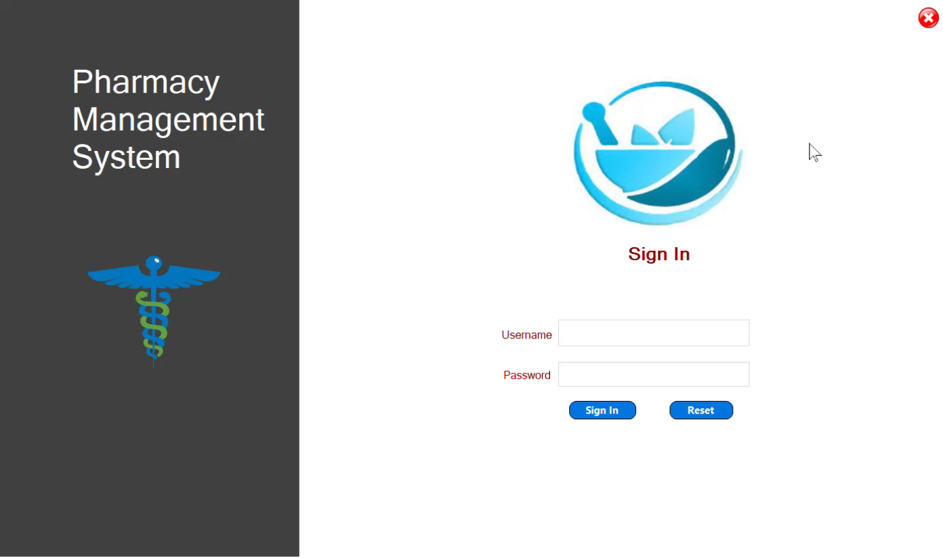
Documentation: Tutorial Video
Admin Log In

Slide 17
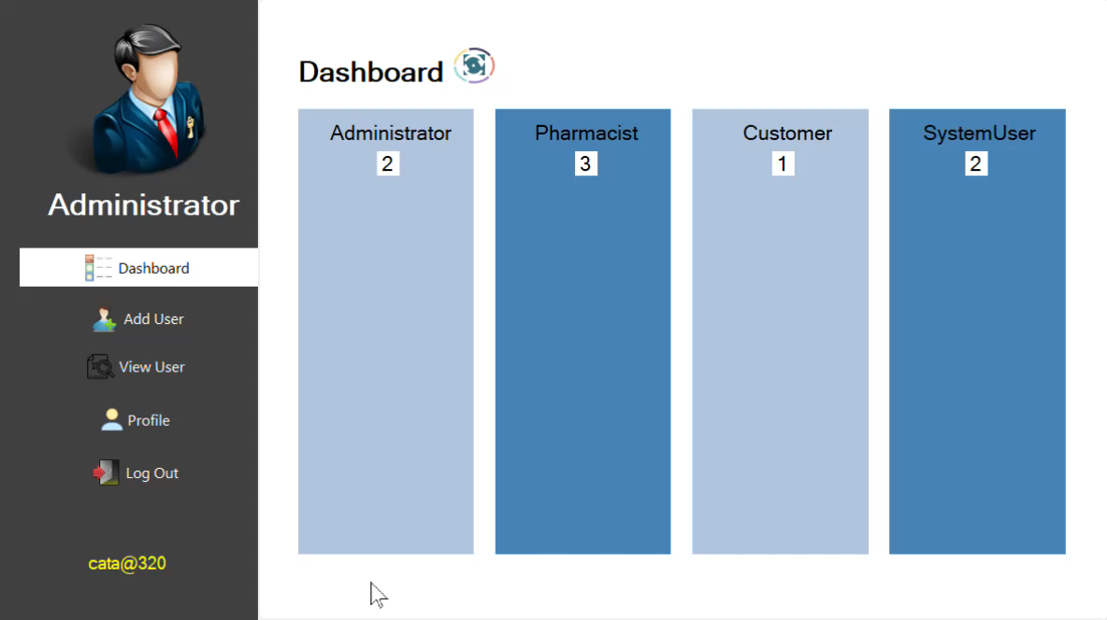
Documentation: Tutorial Video
Admin User Controls

Slide 18

Documentation: Tutorial Video
Pharmacist Log In

Slide 19
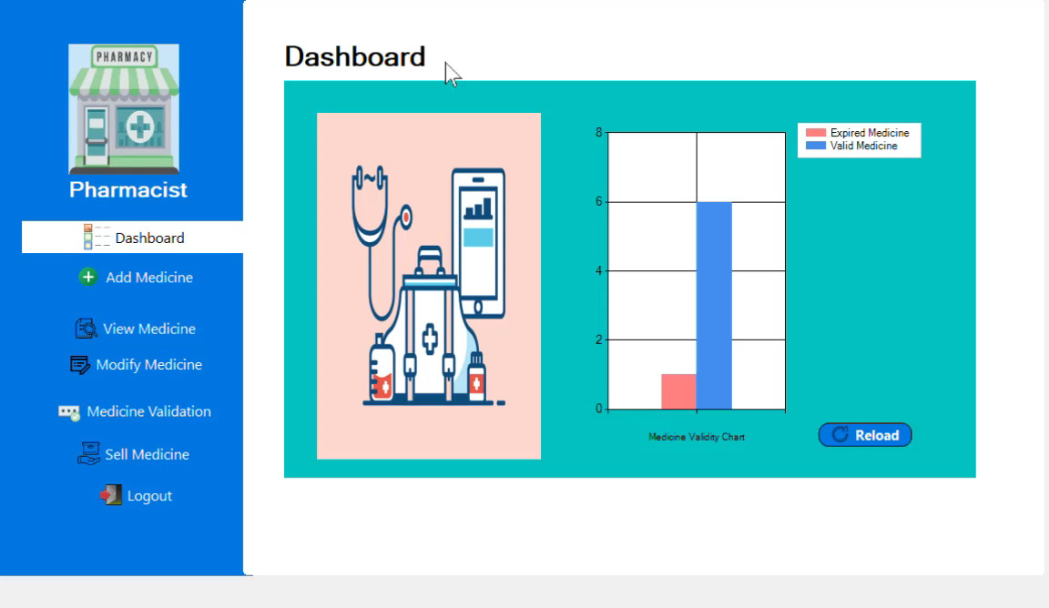
Documentation: Tutorial Video
Pharmacist User Controls

Slide 20

Documentation: Tutorial Video
User Log Out and System Exit

Slide 21
After Action Review (AAR)
What Was Supposed to Happen?
All users like Admin, Pharmacist, Customer, other System Users should have individual user controls/modules/classes.
All functionalities for each user type should be included in the program/ code
What Actually Happened?
Main system users: Admin and Pharmacist, user controls were included in the program as individual classes.
85-90% of the main and extended functionalities were created in the program as methods of their respective classes.
Program is 85% completed and functional.
Why Was There A Difference?
There were some constraints involved such as:
short timescale,
lack of resources like computing power of my hardware,
and plenty of bugs to find and fix.
What Can I Learn From This?
Improve my time management skills; I should allot more time than what I originally anticipate in finishing my work.
Improve my coding skills.
Plan better

Slide 22

Reference
Slide Team. (2021). After Action Review Matrix Questions Text Boxes. Retrieved from: https://www.slideteam.net/after-action-review-matrix-questions-text-boxes.html
Note: Source code and database samples are submitted through this GitHub link.

